Slide 1


Slide 2
DEEP LEARNING COURSE
SPRING 2026
Usman Khan, PhD

Slide 3
PRAYERS BREAK till 1850 / 0650 PM

Slide 4
CONVOLUTIONAL NEURAL NETWORKS
The last layer in a CNN uses these higher-level features to make predictions regarding the contents of the image
In practice, CNNs give us two key benefits: local invariance and compositionality.
The concept of local invariance allows us to classify an image as containing a particular object regardless of where in the image the object appears.
We obtain this local invariance through the usage of "pooling layers” which identifies regions of our input volume with a high response to a particular filter
The second benefit is compositionality. Each filter composes a local patch of lower-level features into a higher-level representation, similar to how we can compose a set of mathematical functions that build on the output of previous functions: f (g(x(h(x))) – this composition allows our network to learn more rich features deeper in the network.
For example, our network may build edges from pixels, shapes from edges, and then complex objects from shapes – all in an automated fashion that happens naturally during the training process.
The concept of building higher-level features from lower-level ones is exactly why CNNs are so powerful in computer vision.
Ever apply blurring or smoothing to an image? Yep, that’s a convolution. What about edge detection? Yup, convolution. Have you opened Photoshop or GIMP to sharpen an image? You guessed it – convolution. Convolutions are one of the most critical, fundamental building-blocks in computer vision and image processing.

Slide 5



CONVOLUTIONAL NEURAL NETWORKS
What is a Convolution
In terms of deep learning, an (image) convolution is an element-wise multiplication of two matrices followed by a sum
Using cross-correlation instead of convolution is actually by design.
Convolution over a two-dimensional input image I and two-dimensional kernel K is defined as :
However, nearly all machine learning and deep learning libraries use the simplified crosscorrelation function

Slide 6
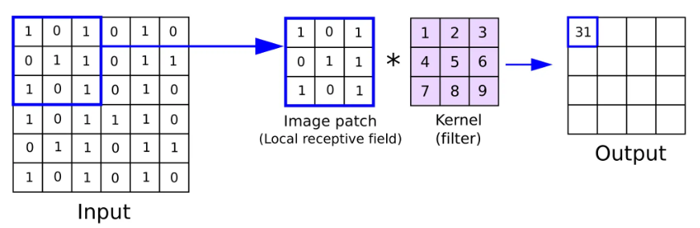
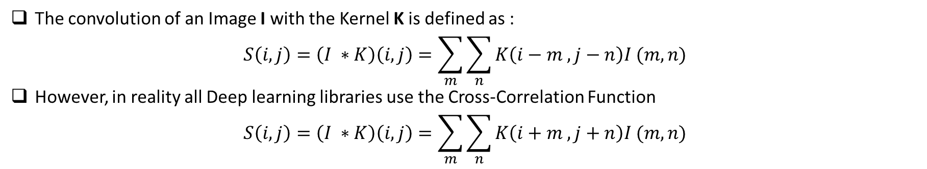
CONVOLUTIONAL NEURAL NETWORKS
The convolution of an Image I with the Kernel K is defined as :
$$S\left(i,j\right)=\left(I ∗K\right)\left(i,j\right)=\sum_{m}{\sum_{n}{K\left(i−m , j−n\right)I (m,n)}}$$
However, in reality all Deep learning libraries use the Cross-Correlation Function
$$S\left(i,j\right)=\left(I ∗K\right)\left(i,j\right)=\sum_{m}{\sum_{n}{K\left(i+m , j+n\right)I (m,n)}}$$
We can think of an image as big matrix and a kernel or convolutional matrix as a tiny matrix that is used for blurring, sharpening, edge detection, and other processing functions.

Slide 7
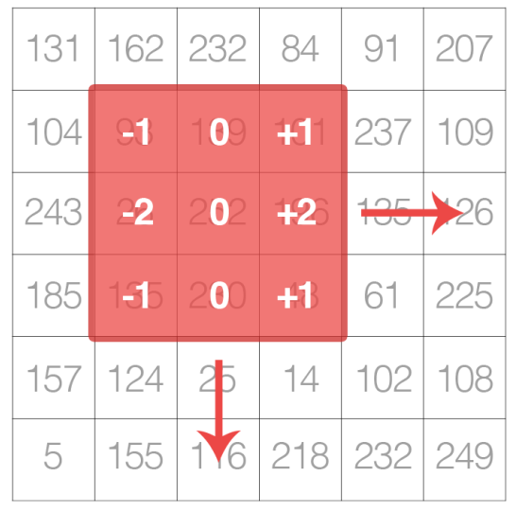
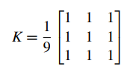
CONVOLUTIONAL NEURAL NETWORKS
Essentially, this tiny kernel sits on top of the big image and slides from left-to-right and top-to-bottom, applying a mathematical operation (i.e., a convolution) at each (x;y)-coordinate of the original image
You might already be familiar with blurring (average smoothing, Gaussian smoothing, median smoothing, etc.), edge detection (Laplacian, Sobel, Scharr, Prewitt, etc.), and sharpening – all of these operations are forms of hand-defined kernels that are specifically designed to perform a particular function
Is there a way to automatically learn these types of filters? And even use these filters for image classification and object detection?
As the figure demonstrates, we are sliding the kernel (red region) from left-to-right and top-to-bottom along the original image. At each (x;y)-coordinate of the original image, we stop and examine the neighborhood of pixels located at the center of the image kernel.
We then take this neighborhood of pixels, convolve them with the kernel, and obtain a single output value.
The output value is stored in the output image at the same (x;y)-coordinates as the center of the kernel
Edge Filter
Averaging Filter

Slide 8
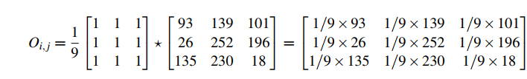
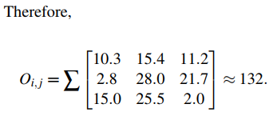
CONVOLUTIONAL NEURAL NETWORKS
Convolution (i.e., cross-correlation) is actually very easy. All we need to do is:
Select an (x;y)-coordinate from the original image.
Place the center of the kernel at this (x;y)-coordinate.
Take the element-wise multiplication of the input image region and the kernel, then sum up the values of these multiplication operations into a single value. The sum of these multiplications is called the kernel output.
Use the same (x;y)-coordinates from Step #1, but this time, store the kernel output at the same (x;y)-location as the output image.

Slide 9
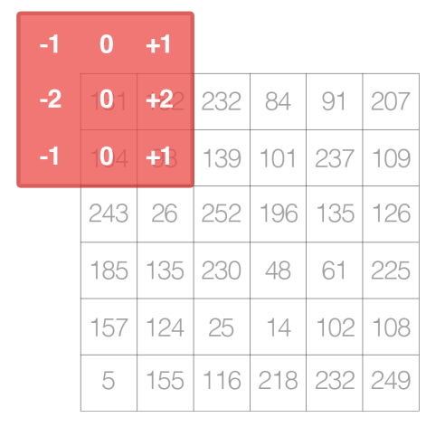
CONVOLUTIONAL NEURAL NETWORKS
Applying the convolution, and then storing the output, which will actually decrease the spatial dimensions of our input image
Recall that we “center” our computation around the center (x;y)-coordinate of the input image that the kernel is currently positioned over.
The decrease in spatial dimension is simply a side effect of applying convolutions to images. Sometimes this effect is desirable, and other times it is not, it simply depends on your application.
However, in most cases, we want our output image to have the same dimensions as our input image. To ensure the dimensions are the same, we apply padding
Other padding methods exist, including zero padding (filling the borders with zeros – very common when building Convolutional Neural Networks) and wrap around (where the border pixels are determined by examining the opposite side of the image). In most cases, you will see either replicate or zero padding. Replicate padding is more commonly used when aesthetics are concerned while zero padding is best for efficiency.

Slide 10
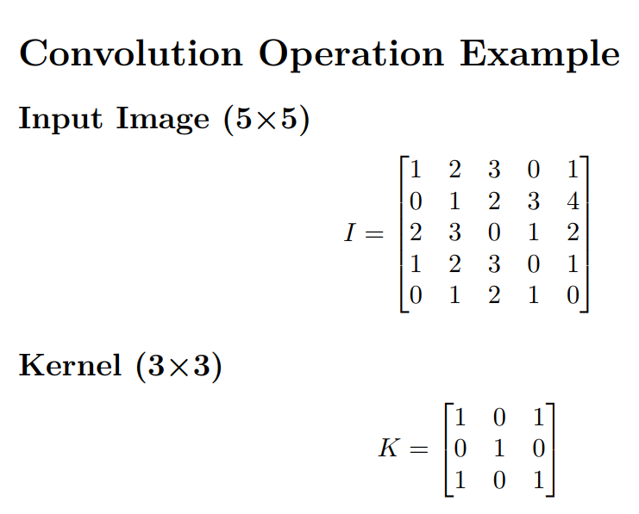
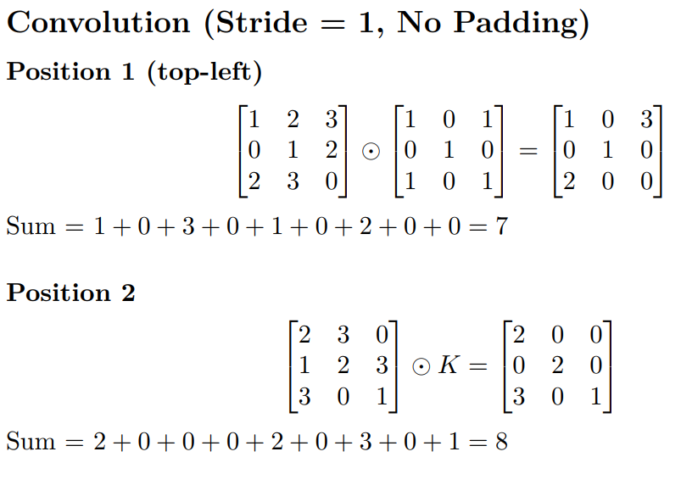
CONVOLUTIONAL NEURAL NETWORKS

Slide 11
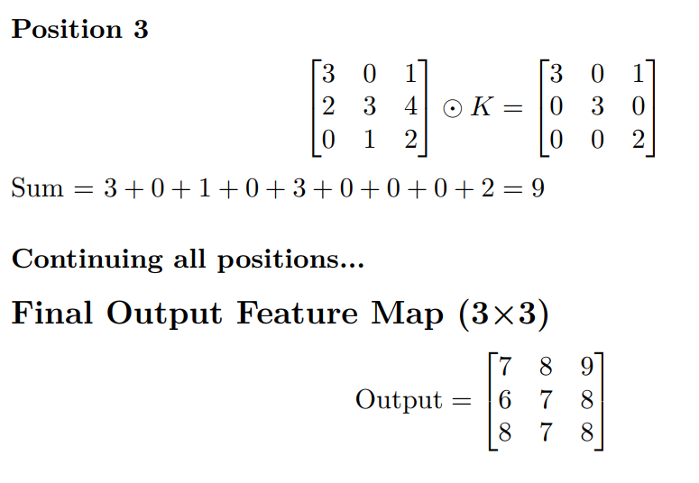
CONVOLUTIONAL NEURAL NETWORKS

Slide 12
CONVOLUTIONAL NEURAL NETWORKS
from skimage.exposure import rescale_intensity
import numpy as np
import argparse
import cv2
def convolve(image, K):
# grab the spatial dimensions of the image and kernel
(iH, iW) = image.shape[:2]
(kH, kW) = K.shape[:2]
# calculate the padding to preserve the spatial dimensions
pad = (kW - 1) // 2
image = cv2.copyMakeBorder(image, pad, pad, pad, pad, cv2.BORDER_REPLICATE)

Slide 13
CONVOLUTION
# allocate memory for the output image
output = np.zeros((iH, iW), dtype="float32")
# loop over the input image, "sliding" the kernel across each (x, y)-coordinate
for y in np.arange(pad, iH + pad):
for x in np.arange(pad, iW + pad):
# extract the Region of Interest (ROI) of the image by the kernel size
roi = image[y - pad:y + pad + 1, x - pad:x + pad + 1]
# perform the convolution by element-wise multiplication and summing up
k = (roi * K).sum()
# store the convolved value in the output image
output[y - pad, x - pad] = k
# rescale the output image to be in the range [0, 255]
output = rescale_intensity(output, in_range=(output.min(), output.max()))
output = (output * 255).astype("uint8")
# return the output image
return output

Slide 14
CONVOLUTION
# Argument parsing (for command line input)
ap = argparse.ArgumentParser()
ap.add_argument("-i", "--image", required=True, help="Path to the input image")
args = vars(ap.parse_args())
# Define the kernel filters
smallBlur = np.ones((7, 7), dtype="float") * (1.0 / (7 * 7))
largeBlur = np.ones((21, 21), dtype="float") * (1.0 / (21 * 21))
sharpen = np.array((
[0, -1, 0],
[-1, 5, -1],
[0, -1, 0]
), dtype="int")

Slide 15
CONVOLUTION
laplacian = np.array((
[0, 1, 0],
[1, -4, 1],
[0, 1, 0]
), dtype="int")
sobelX = np.array((
[1, 0,-1],
[2, 0, -2],
[1, 0, -1]
), dtype="int")
sobelY = np.array((
[1, 2, 1],
[0, 0, 0],
[-1, -2, -1]
), dtype="int")
emboss = np.array((
[-2, -1, 0],
[-1, 1, 1],
[0, 1, 2]
), dtype="int")
kernelBank = (
("small_blur", smallBlur),
("large_blur", largeBlur),
("sharpen", sharpen),
("laplacian", laplacian),
("sobel_x", sobelX),
("sobel_y", sobelY),
("emboss", emboss)
)
# Load the input image and convert it to grayscale
image = cv2.imread(args["image"])
gray = cv2.cvtColor(image, cv2.COLOR_BGR2GRAY)

Slide 16
CONVOLUTION
# Load the input image and convert it to grayscale
image = cv2.imread(args["image"])
gray = cv2.cvtColor(image, cv2.COLOR_BGR2GRAY)
# Loop over the kernels and apply them using both custom convolution and OpenCV's filter2D
for (kernelName, K) in kernelBank:
print("INFO applying {} kernel".format(kernelName))
# Apply the custom convolution function
convolveOutput = convolve(gray, K)
# Apply OpenCV's filter2D function
opencvOutput = cv2.filter2D(gray, -1, K)
# Show the original and filtered images side by side
cv2.imshow("Original", gray)
cv2.imshow("{} - Convolve Manual".format(kernelName), convolveOutput)
#cv2.imshow("{} - OpenCV".format(kernelName), opencvOutput)
# Wait for a keypress and close the windows
cv2.waitKey(0)
cv2.destroyAllWindows()

Slide 17
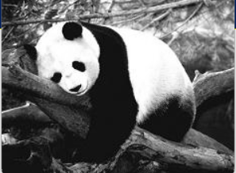
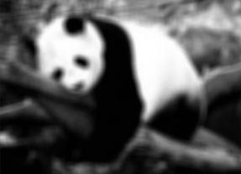
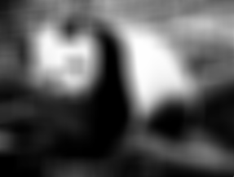
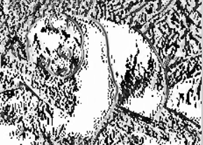
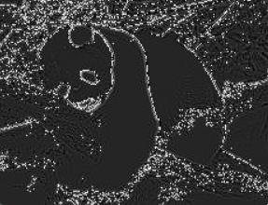
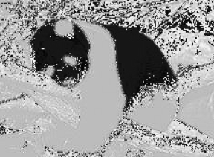
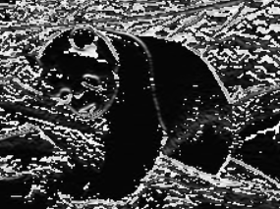
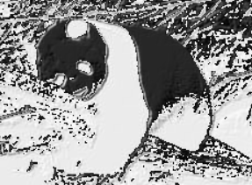
COVOLUTIONAL FILTERS
Small blur
Large blur
Sobel X
Laplacian
Sharpen
Sobel Y
Emboss

Slide 18
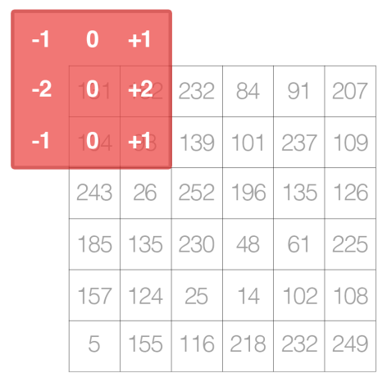
CONVOLUTIONAL NEURAL NETWORKS
If we attempted to apply convolution at the pixel located at (0;0), then our 3×3 kernel would “hang off” off the edge of the image. Notice how there are no input image pixel values for the first row and first column of the kernel. Because of this, we always either
(1) Start convolution at the first valid position
(2) Apply zero padding
As you’ve gathered from this section, we must manually hand-define each of our kernels for each of our various image processing operations, such as smoothing, sharpening, and edge detection. That’s all fine and good, but what if there was a way to learn these filters instead?
Is it possible to define a machine learning algorithm that can look at our input images and eventually learn these types of operators? In fact, there is – these types of algorithms are the primary focus of this book: Convolutional Neural Networks (CNNs).
By applying convolutions filters, nonlinear activation functions, pooling, and backpropagation, CNNs are able to learn filters that can detect edges and blob-like structures in lower-level layers of the network – and then use the edges and structures as “building blocks”, eventually detecting high-level objects (e.x., faces, cats, dogs, cups, etc.) in the deeper layers of the network.

Slide 19
CONVOLUTIONAL NEURAL NETWORKS
Artificial neural networks accept an input image/feature vector (one input node for each entry) and transform it through a series of hidden layers, commonly using nonlinear activation functions. Each hidden layer is also made up of a set of neurons, where each neuron is fully-connected to all neurons in the previous layer.
Artificial Neural Networks have scalability issues as the image size increases and also has lesser accuracy
To demonstrate how standard neural networks do not scale well as image size increases, let’s again consider the CIFAR-10 dataset. Each image in CIFAR-10 is 32×32 with a Red, Green, and Blue channel, yielding a total of 32×32×3 = 3;072 total inputs to our network
A total of 3;072 inputs does not seem to amount to much, but consider if we were using 250×250 pixel images – the total number of inputs and weights would jump to 250×250×3 = 187;500 – and this number is only for the input layer alone! Surely, we would want to add multiple hidden layers with varying number of nodes per lay – these parameters can quickly add up, and given the poor performance of standard neural networks on raw pixel intensities, this bloat is hardly worth it.

Slide 20
CONVOLUTIONAL NEURAL NETWORKS
Unlike a standard neural network, layers of a CNN are arranged in a 3D volume in three dimensions: width, height, and depth (where depth refers to the third dimension of the volume, such as the number of channels in an image or the number of filters in a layer).
To make this example more concrete, again consider the CIFAR-10 dataset: the input volume will have dimensions 32×32×3 (width, height, and depth, respectively). Neurons in subsequent layers will only be connected to a small region of the layer before it (rather than the fully-connected structure of a standard neural network) – we call this local connectivity which enables us to save a huge amount of parameters in our network. Finally, the output layer will be a 1×1×N volume which represents the image distilled into a single vector of class scores. In the case of CIFAR-10, given ten classes, N = 10, yielding a 1×1×10 volume
There are many types of layers used to build CNNs but most commonly encountered are:-
Convolution
Activation (ACT or RELU)
Pooling (POOL)
Fully Connected (FC)
Batch Normalization (BN)
Drop Out (DO

Slide 21
CONVOLUTIONAL NEURAL NETWORKS
Unlike a standard neural network, layers of a CNN are arranged in a 3D volume in three dimensions: width, height, and depth (where depth refers to the third dimension of the volume, such as the number of channels in an image or the number of filters in a layer).
To make this example more concrete, again consider the CIFAR-10 dataset: the input volume will have dimensions 32×32×3 (width, height, and depth, respectively). Neurons in subsequent layers will only be connected to a small region of the layer before it (rather than the fully-connected structure of a standard neural network) – we call this local connectivity which enables us to save a huge amount of parameters in our network. Finally, the output layer will be a 1×1×N volume which represents the image distilled into a single vector of class scores. In the case of CIFAR-10, given ten classes, N = 10, yielding a 1×1×10 volume
There are many types of layers used to build CNNs but most commonly encountered are:-
Convolution
Activation (ACT or RELU)
Pooling (POOL)
Fully Connected (FC)
Batch Normalization (BN)
Drop Out (DO

Slide 22
CONVOLUTIONAL NEURAL NETWORKS
Stacking s series of these layers yelds CNN
INPUT => CONV => RELU => FC => SOFTMAX
Here we define a simple CNN that accepts an input, applies a convolution layer, then an activation layer, then a fully-connected layer, and, finally, a softmax classifier to obtain the output classification probabilities.
The SOFTMAX activation layer is often omitted from the network diagram as it is assumed it directly follows the final FC.
Of these layer types, CONV and FC, (and to a lesser extent, BN) are the only layers that contain parameters that are learned during the training process
. ctivation and dropout layers are not considered true “layers" themselves, but are often included in network diagrams to make the architecture explicitly clear.
Pooling layers (POOL), of equal importance as CONV and FC, are also included in network diagrams as they have a substantial impact on the spatial dimensions of an image as it moves through a CNN

Slide 23
CONVOLUTIONAL NEURAL NETWORKS
CONV, POOL, RELU, and FC are the most important when defining your actual network architecture. That’s not to say that the other layers are not critical, but take a backseat to this critical set of four as they define the actual architecture itself
Activation functions themselves are practically assumed to be part of the architecture, When defining CNN architectures we often omit the activation layers from a table/diagram to save space; however, the activation layers are implicitly assumed to be part of the architecture.
The CONV layer is the core building block of a Convolutional Neural Network. The CONV layer parameters consist of a set of K learnable filters (i.e., “kernels”), where each filter has a width and a height, and are nearly always square.
These filters are small (in terms of their spatial dimensions) but extend throughout the full depth of the volume
For inputs to the CNN, the depth is the number of channels in the image (i.e., a depth of three when working with RGB images, one for each channel). For volumes deeper in the network, the depth will be the number of filters applied in the previous layer.

Slide 24
CONVOLUTIONAL NEURAL NETWORKS
To make this concept more clear, let’s consider the forward-pass of a CNN, where we convolve each of the K filters across the width and height of the input volume
More simply, we can think of each of our K kernels sliding across the input region, computing an element-wise multiplication, summing, and then storing the output value in a 2- dimensional activation map,
After applying all K filters to the input volume, we now have K, 2-dimensional activation maps. We then stack our K activation maps along the depth dimension of our array to form the final output volume
Every entry in the output volume is thus an output of a neuron that “looks” at only a small region of the input. In this manner, the network “learns” filters that activate when they see a specific type of feature at a given spatial location in the input volume. In lower layers of the network, filters may activate when they see edge-like or corner-like regions
Then, in the deeper layers of the network, filters may activate in the presence of high-level features, such as parts of the face, the paw of a dog, the hood of a car, etc.
The concept of convolving a small filter with a large(r) input volume has special meaning in Convolutional Neural Networks – specifically, the local connectivity and the receptive field of a neuron.

Slide 25
CONVOLUTIONAL NEURAL NETWORKS
When working with images, it’s often impractical to connect neurons in the current volume to all neurons in the previous volume – there are simply too many connections and too many weights, making it impossible to train deep networks on images with large spatial dimensions.
Instead, when utilizing CNNs, we choose to connect each neuron to only a local region of the input volume – we call the size of this local region the receptive field (or simply, the variable F) of the neuron
To make this point clear, let’s return to our CIFAR-10 dataset where the input volume as an input size of 32×32×3. Each image thus has a width of 32 pixels, a height of 32 pixels, and a depth of 3 (one for each RGB channel). If our receptive field is of size 3×3, then each neuron in the CONV layer will connect to a 3×3 local region of the image for a total of 3×3×3 = 27 weights
Remember, the depth of the filters is three because they extend through the full depth of the input image, in this case, three channels
let’s assume that the spatial dimensions of our input volume have been reduced to a smaller size, but our depth is now larger, due to utilizing more filters deeper in the network, such that the volume size is now 16×16×94.
If we assume a receptive field of size 3×3, then every neuron in the CONV layer will have a total of 3×3×94 = 846 connections to the input volume. Simply put, the receptive field F is the size of the filter, yielding an F ×F kernel that is convolved with the input volume

Slide 26
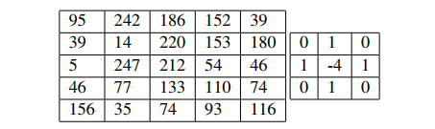

CONVOLUTIONAL NEURAL NETWORKS
There are three parameters that control the size of an output volume: the depth, stride, and zero-padding size
The depth of an output volume controls the number of neurons (i.e., filters) in the CONV layer that connect to a local region of the input volume.
Each filter produces an activation map that “activate” in the presence of oriented edges or blobs or color.
For a given CONV layer, the depth of the activation map will be K, or simply the number of filters we are learning in the current layer. The set of filters that are “looking at” the same (x;y) location of the input is called the depth column
We create a new depth column around the local region of the image where we convolve each of the K filters with the region and store the output in a 3D volume. When creating our CONV layers we normally use a stride step size S of either S = 1 or S = 2.
Smaller strides will lead to overlapping receptive fields and larger output volumes
Conversely, larger strides will result in less overlapping receptive fields and smaller output volumes.
To make the concept of convolutional stride more concrete, consider the table where we have a 5×5 input image (left) along with a 3×3 Laplacian kernel (right)
Table
Table 2

Slide 27
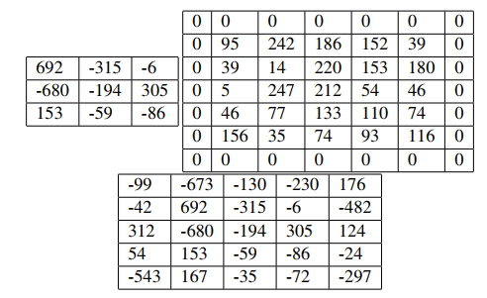
CONVOLUTIONAL NEURAL NETWORKS
Using S = 1, our kernel slides from left-to-right and top-to-bottom, one pixel at a time, producing the following output
However, if we were to apply the same operation, only this time with a stride of S = 2, we skip two pixels at a time (two pixels along the x-axis and two pixels along the y-axis), producing a smaller output volume (right) table 2
Convolutional layers and pooling layers are the primary methods to reduce spatial input size
We need to “pad” the borders of an image to retain the original image size when applying a convolution – the same is true for filters inside of a CNN. Using zero-padding, we can “pad” our input along the borders such that our output volume size matches our input volume size
The amount of padding we apply is controlled by the parameter P.
This technique is especially critical when we start looking at deep CNN architectures that apply multiple CONV filters on top of each other.
If we instead set P = 1, we can pad our input volume with zeros (middle) to create a 7 × 7 volume and then apply the convolution operation, leading to an output volume size that matches the original input volume size of 5×5.
Without zero padding, the spatial dimensions of the input volume would decrease too quickly, and we wouldn’t be able to train deep networks
Table 3

Slide 28
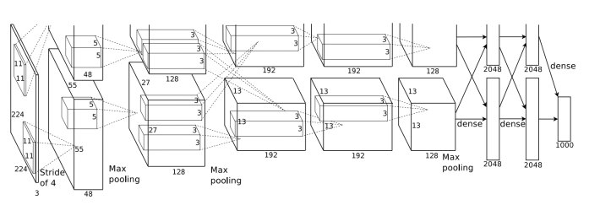
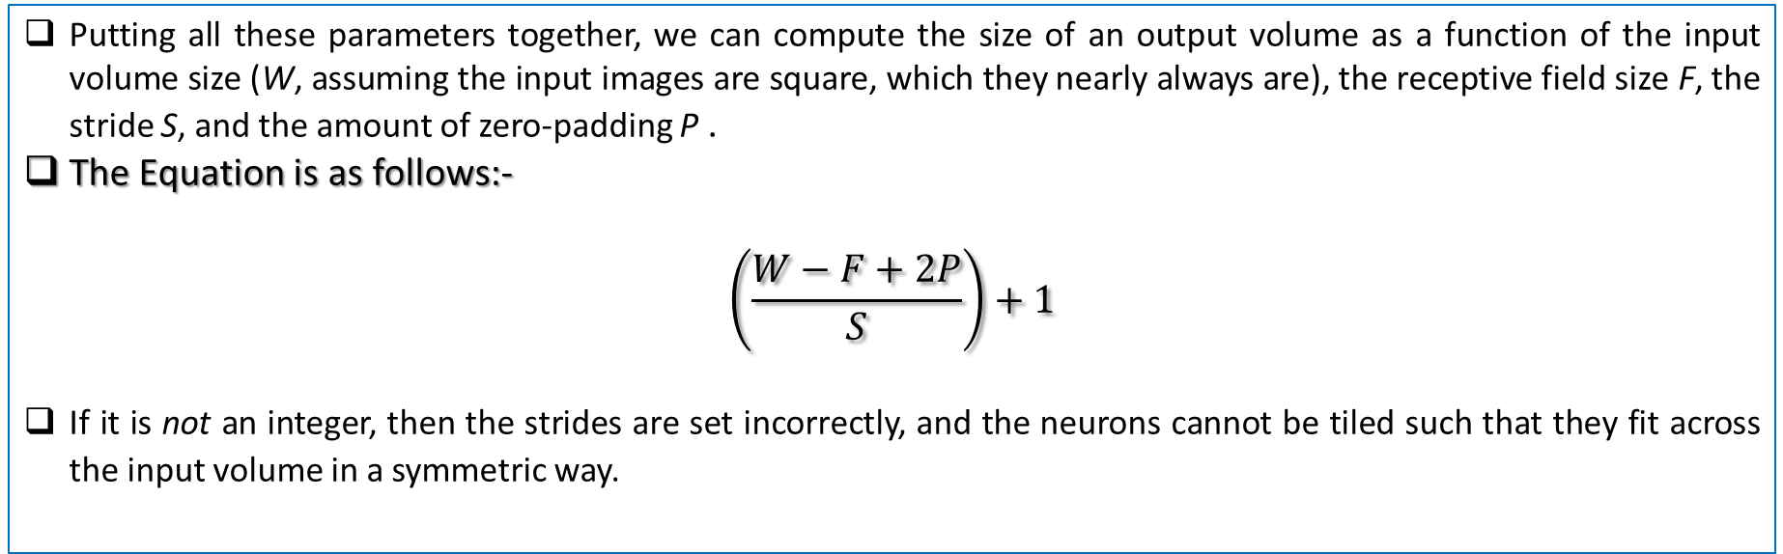
CONVOLUTIONAL NEURAL NETWORKS
Putting all these parameters together, we can compute the size of an output volume as a function of the input volume size (W, assuming the input images are square, which they nearly always are), the receptive field size F, the stride S, and the amount of zero-padding P .
The Equation is as follows:-
$$\left(\frac{W−F+2P}{S}\right)+1$$
If it is not an integer, then the strides are set incorrectly, and the neurons cannot be tiled such that they fit across the input volume in a symmetric way.

Slide 29
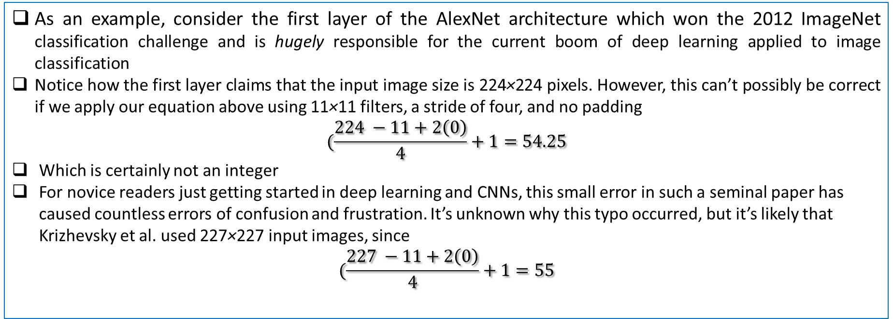
CONVOLUTIONAL NEURAL NETWORKS
As an example, consider the first layer of the AlexNet architecture which won the 2012 ImageNet classification challenge and is hugely responsible for the current boom of deep learning applied to image classification
Notice how the first layer claims that the input image size is 224×224 pixels. However, this can’t possibly be correct if we apply our equation above using 11×11 filters, a stride of four, and no padding
$$(\frac{224 −11+2\left(0\right)}{4}+1=54.25$$
Which is certainly not an integer
For novice readers just getting started in deep learning and CNNs, this small error in such a seminal paper has caused countless errors of confusion and frustration. It’s unknown why this typo occurred, but it’s likely that Krizhevsky et al. used 227×227 input images, since
$$(\frac{227 −11+2\left(0\right)}{4}+1=55$$

Slide 30
PRAYERS BREAK till 2050 / 0850 PM

Slide 31
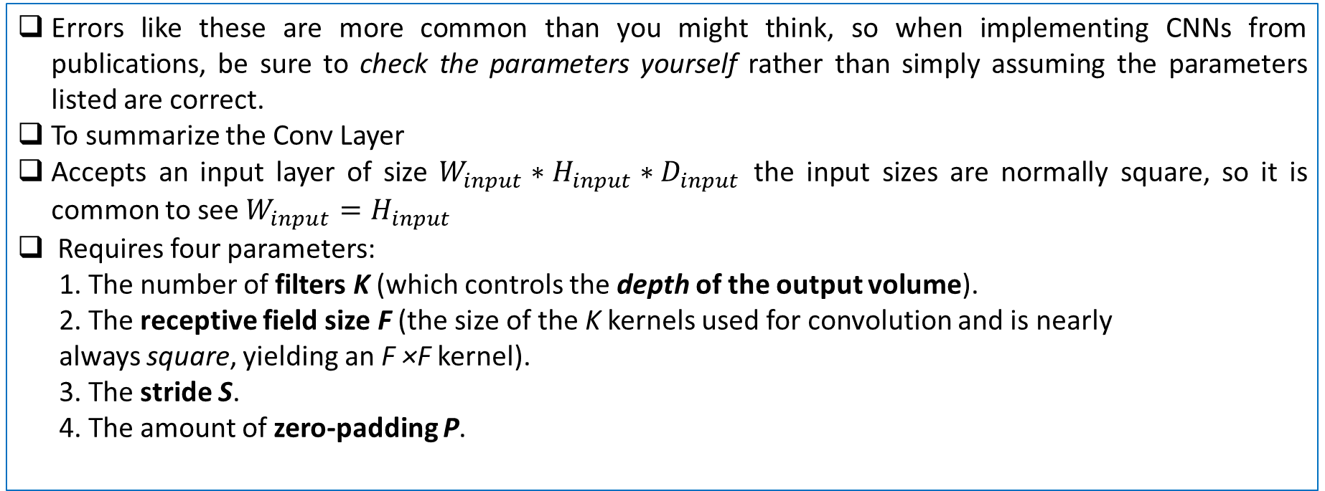
CONVOLUTIONAL NEURAL NETWORKS
Errors like these are more common than you might think, so when implementing CNNs from publications, be sure to check the parameters yourself rather than simply assuming the parameters listed are correct.
To summarize the Conv Layer
Accepts an input layer of size $W_{input}∗H_{input}∗D_{input}$ the input sizes are normally square, so it is common to see $W_{input}=H_{input}$
Requires four parameters:
1. The number of filters K (which controls the depth of the output volume).
2. The receptive field size F (the size of the K kernels used for convolution and is nearly
always square, yielding an F ×F kernel).
3. The stride S.
4. The amount of zero-padding P.

Slide 32
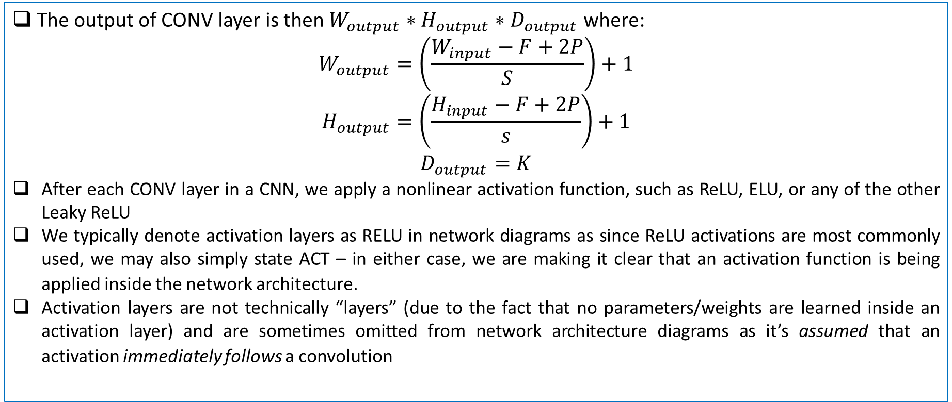
CONVOLUTIONAL NEURAL NETWORKS
The output of CONV layer is then $W_{output}∗H_{output}∗D_{output}$ where:
$$W_{output}=\left(\frac{W_{input}−F+2P}{S}\right)+1$$
$$H_{output}=\left(\frac{H_{input}−F+2P}{s}\right)+1$$
$$D_{output}=K$$
After each CONV layer in a CNN, we apply a nonlinear activation function, such as ReLU, ELU, or any of the other Leaky ReLU
We typically denote activation layers as RELU in network diagrams as since ReLU activations are most commonly used, we may also simply state ACT – in either case, we are making it clear that an activation function is being applied inside the network architecture.
Activation layers are not technically “layers” (due to the fact that no parameters/weights are learned inside an activation layer) and are sometimes omitted from network architecture diagrams as it’s assumed that an activation immediately follows a convolution

Slide 33
CONVOLUTIONAL NEURAL NETWORKS
A basic layout of the CNN is as follows
INPUT => CONV => RELU => FC
Since the activation function is applied in an element-wise manner, the output of an activation layer is always the same as the input dimension, Winput = Wout put, Hinput = Hout put, Dinput = Dout put.
Question: You have an image of size 227 x 227 x 3. The filter size is 3 x 3 x 1. If you keep the stride S = 1, padding P = 0 and keep on applying the filter three times, what is the dimension of the output features

Slide 34
CONVOLUTIONAL NEURAL NETWORKS
Question: If you have an image of size 227 x 227 x 3 and need an output of size 27 x 27 x 1 what should be filter size F, stride S, padding P if you have to make it happen in only one step.

Slide 35
CONVOLUTIONAL NEURAL NETWORKS
An activation layer accepts an input volume of size Winput ×Hinput ×Dinput and then applies the given activation function (Figure 11.9). Since the activation function is applied in an element-wise manner, the output of an activation layer is always the same as the input dimension, Winput = Wout put, Hinput = Hout put, Dinput = Dout put.
Pooling Layers
There are two methods to reduce the size of an input volume – CONV layers with a stride > 1 (which we’ve already seen) and POOL layers. It is common to insert POOL layers in-between consecutive CONV layers in a CNN architectures:
INPUT => CONV => RELU => POOL => CONV => RELU => POOL => FC
The primary function of the POOL layer is to progressively reduce the spatial size (i.e., width and height) of the input volume. Doing this allows us to reduce the amount of parameters and computation in the network – pooling also helps us control overfitting.
POOL layers operate on each of the depth slices of an input independently using either the max or average function. Max pooling is typically done in the middle of the CNN architecture to reduce spatial size, whereas average pooling is normally used as the final layer of the network (e.x., GoogLeNet, SqueezeNet, ResNet) where we wish to avoid using FC layers entirely. The most common type of POOL layer is max pooling, although this trend is changing with the introduction of more exotic micro-architectures.

Slide 36
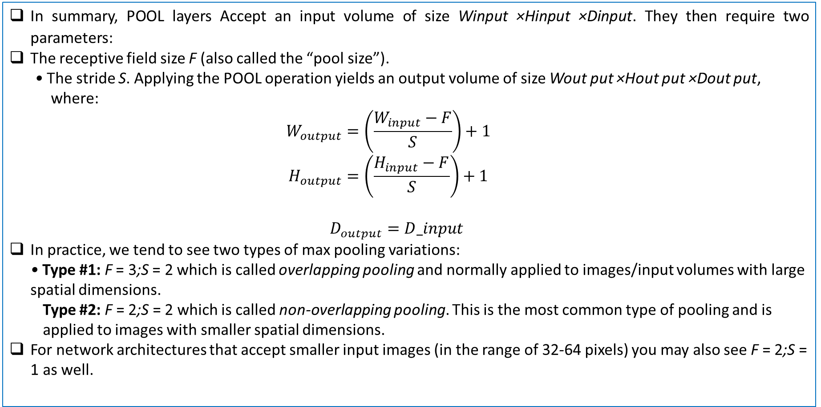
CONVOLUTIONAL NEURAL NETWORKS
In summary, POOL layers Accept an input volume of size Winput ×Hinput ×Dinput. They then require two parameters:
The receptive field size F (also called the “pool size”).
• The stride S. Applying the POOL operation yields an output volume of size Wout put ×Hout put ×Dout put, where:
$$W_{output}=\left(\frac{W_{input}−F}{S}\right)+1$$
$$H_{output}=\left(\frac{H_{input}−F}{S}\right)+1$$
$$D_{output}=D_input$$
In practice, we tend to see two types of max pooling variations:
• Type #1: F = 3;S = 2 which is called overlapping pooling and normally applied to images/input volumes with large spatial dimensions.
Type #2: F = 2;S = 2 which is called non-overlapping pooling. This is the most common type of pooling and is applied to images with smaller spatial dimensions.
For network architectures that accept smaller input images (in the range of 32-64 pixels) you may also see F = 2;S = 1 as well.

Slide 37
CONVOLUTIONAL NEURAL NETWORKS
In their 2014 paper, Striving for Simplicity: The All Convolutional Net, Springenberg et al. recommend discarding the POOL layer entirely and simply relying on CONV layers with a larger stride to handle downsampling the spatial dimensions of the volume. Their work demonstrated this approach works very well on a variety of datasets, including CIFAR-10 (small images, low number of classes) and ImageNet (large input images, 1,000 classes). This trend continues with the ResNet architecture which uses CONV layers for downsampling as well.
It’s becoming increasingly more common to not use POOL layers in the middle of the network architecture and only use average pooling at the end of the network if FC layers are to be avoided. Perhaps in the future there won’t be pooling layers in Convolutional Neural Networks – but in the meantime, it’s important that we study them, learn how they work, and apply them to our own architectures.
FC layers are always placed at the end of the network (i.e., we don’t apply a CONV layer, then an FC layer, followed by another CONV) layer.
It’s common to use one or two FC layers prior to applying the softmax classifier, as the following (simplified) architecture demonstrates:
INPUT => CONV => RELU => POOL => CONV => RELU => POOL => FC => FC
Here we apply two fully-connected layers before our (implied) softmax classifier which will compute our final output probabilities for each class.

Slide 38
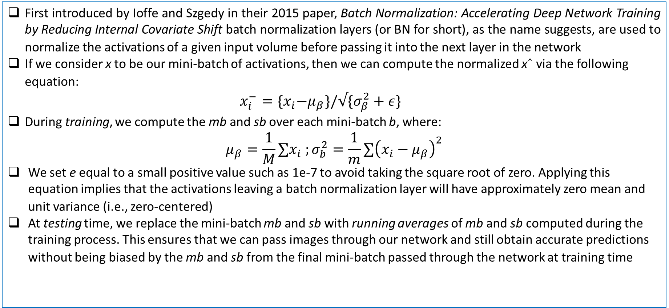
CONVOLUTIONAL NEURAL NETWORKS
First introduced by Ioffe and Szgedy in their 2015 paper, Batch Normalization: Accelerating Deep Network Training by Reducing Internal Covariate Shift batch normalization layers (or BN for short), as the name suggests, are used to normalize the activations of a given input volume before passing it into the next layer in the network
If we consider x to be our mini-batch of activations, then we can compute the normalized xˆ via the following equation: $x_{i}^{−}={\{x}_{i}−μ_{β}\}/√\{σ_{β}^{2}+ε\}$
During training, we compute the mb and sb over each mini-batch b, where:
$$μ_{β}=\frac{1}{M}∑x_{i} ;σ_{b}^{2}=\frac{1}{m}∑{\left(x_{i}−μ_{β}\right)}^{2}$$
We set e equal to a small positive value such as 1e-7 to avoid taking the square root of zero. Applying this equation implies that the activations leaving a batch normalization layer will have approximately zero mean and unit variance (i.e., zero-centered)
At testing time, we replace the mini-batch mb and sb with running averages of mb and sb computed during the training process. This ensures that we can pass images through our network and still obtain accurate predictions without being biased by the mb and sb from the final mini-batch passed through the network at training time

